Slide 1

Team Flash

Slide 2
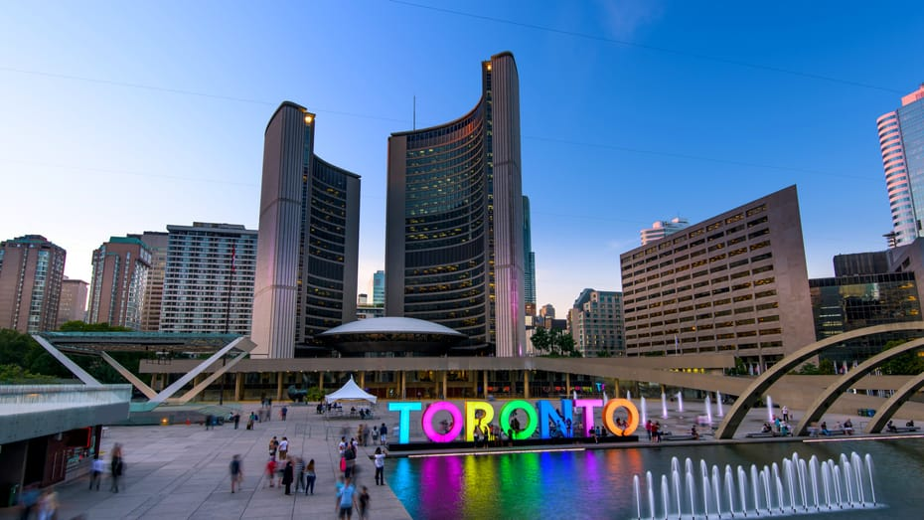
Connected Communities
Our Focus: Child Care in Toronto
Notes:
What innovations and technologies will facilitate healthy and safe connected communities, considering the benefits and needs of human interaction?

Slide 3
Child care in toronto
What are the current challenges?

Slide 4

For Parents and Caregivers
Finding day care centres nearby
Filtering based on their criteria
Connecting with other parents within the community
Notes:
How do I find care centres close to me easily? – Easy to find
How can I sort out care centres based on criteria that I care about (availability and affordability)? – Affordable and Available
How can I connect with other parents within my community for their feedback on particular centres? – Trustworth and Reliable

Slide 5

For Day care centres
Maintaining trust with the parents and caregivers
Connecting with other day care centres for networking and education opportunities
Streamlining waitlist process to provide better service
Notes:
Maintain and measure trust with the parents and caregivers and compare against other providers?
How can we connect with each other for networking and education opportunities?
How can we streamline our waitlist process to provide better service to our clients?

Slide 6

City of Toronto
Consolidating various data sources to be more manageable
Notes:
How can we consolidate all the various data sources to be more manageable?

Slide 7
Our PROPOSAL
Toronto Cares Platform

Slide 8

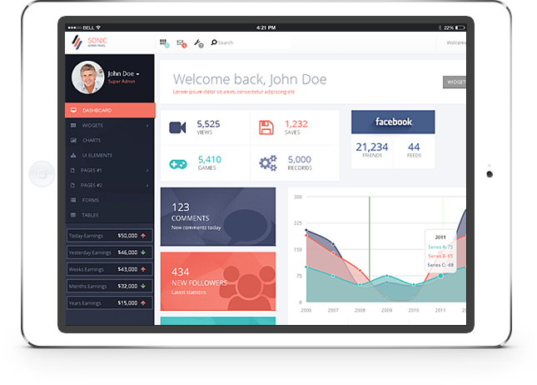
Toronto Cares
An innovative, unique multi-platform solution for child care consisting of
Toronto Cares
AD
Awesome Day Care Dashboard
CVS
XLS
JSON
Bulletin
Manage Waitlist
Review Feedback
Data conversion backend for city of Toronto
Mobile/Web App for Parents and caregivers
Web based dashboard for Child care centres
Notes:
http://www.stickpng.com/img/electronics/android-phones/android-mockup
https://www.hotbootstrap.com/product/sonic-premium-responsive-admin-dashboard-theme/
Start with the problem

Slide 9
Mobile/Web App
Proximity Search
Easy filtering
Real parent reviews
Location: 101 College Street
Location: 101 College Street
Hydrokids-Opg
Filter
Filter
700 University Avenue
Hydrokids-Opg
700 University Avenue
Hydrokids-Opg
700 University Avenue
5
5
5/8
5/8
Age Group | Capacity | Rating
Infant | 10 | 4.21/5
Toddler | 20 | 4.40/5
Preschool | 52 | 4.39/5
I
T
P
$$$
I
T
P
$$$
Orde Day Care Centre
18 Orde Street
5
Queen’s Park Child Care
900 Bay Street
5
5/8
5/8
P
K
S
$$$
I
T
P
$$$
YMCA Child Development
15 Breadalbane Street
5
5/8
Jane Smith: Best child care.
Contact @Jane
Mommyof2: I like their music activities.
Contact @Mommyof2
I
T
P
K
S
$$$
Queen’s Park Child Care
900 Bay Street
5
5/8
I
T
P
$$$
Filter by age groups
Filter by cost $$$
Filter by availability
Provides ratings and comments on care centres
Facilitates connections between parents within communities
Find day care centres near my home or work place
Easy to use UI
I
T
P
K
S
5/8

Slide 10
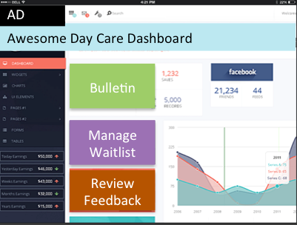

Dashboard

Slide 11
Backend System Processing
CSV
XLS
JSON
Common Data Format for Toronto Cares Platform that does not compromise citizen data

Slide 12
Technology Stack
Java
Spring boot framework
iOS
Angular
Pivotal Cloud Foundry
SSL-encryption

Slide 13
Value proposition
Why use the Toronto Cares Platform?

Slide 14
Toronto Cares – A unique digital platform
Connects families to trustworthy, affordable and available day care centres (resources)
Connects families to other families within the community
Incentivizes day care centres to update their data in order to maintain waitlists and differentiate themselves to target the right audience
Allows day care centres to build their own networks with other day care centres
Transforms the way the city of Toronto stores their data without compromising on citizen privacy
Can be replicated across other resources and services offered within the city (Eg: Libraries)

Slide 15
THANK YOU!
Team Flash Demo

Slide 16
BACKUP SLIDES
Appendix

Slide 17
Did we achieve the challenge and goal?

Slide 18
Mobile Solution for parents and guardians achieves Goal#1
Provides parents/guardians information about care centres closest to them
Provides ratings and comments on care centres thereby allowing parents to engage with other parents in the community
Various income groups can benefit by filtering on affordability
Parents can review and hear back from other parents to built trust in a day care
Goal #1:
Design and build an MVP for a digital platform that can better connect families to each other and the resources, programs and supports available

Slide 19
Dashboard Solution for Day care centres achieves Goal#2
Allows them to maintain their waitlists
Allows them to network with other day care centres
Provides them a platform to hear directly from parents
Allows them to differentiate themselves to appeal to all groups of people
Goal#2:
Through creation of the MVP, incentivize service providers to improve the current access to their information by supplying it in a way that it can be easily presented in the MVP

Slide 20
What is the real problem for day care?

Slide 21
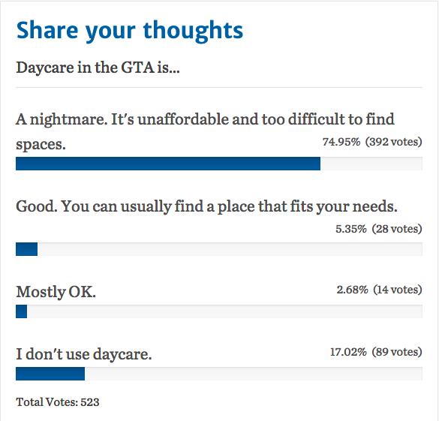
Child care in Toronto
Information from a poll conducted on Toronto Star on June 28, 2018
Notes:
Website Link: https://www.thestar.com/news/gta/2018/06/28/lack-of-licensed-care-creates-daycare-deserts-across-canada.html

Slide 22
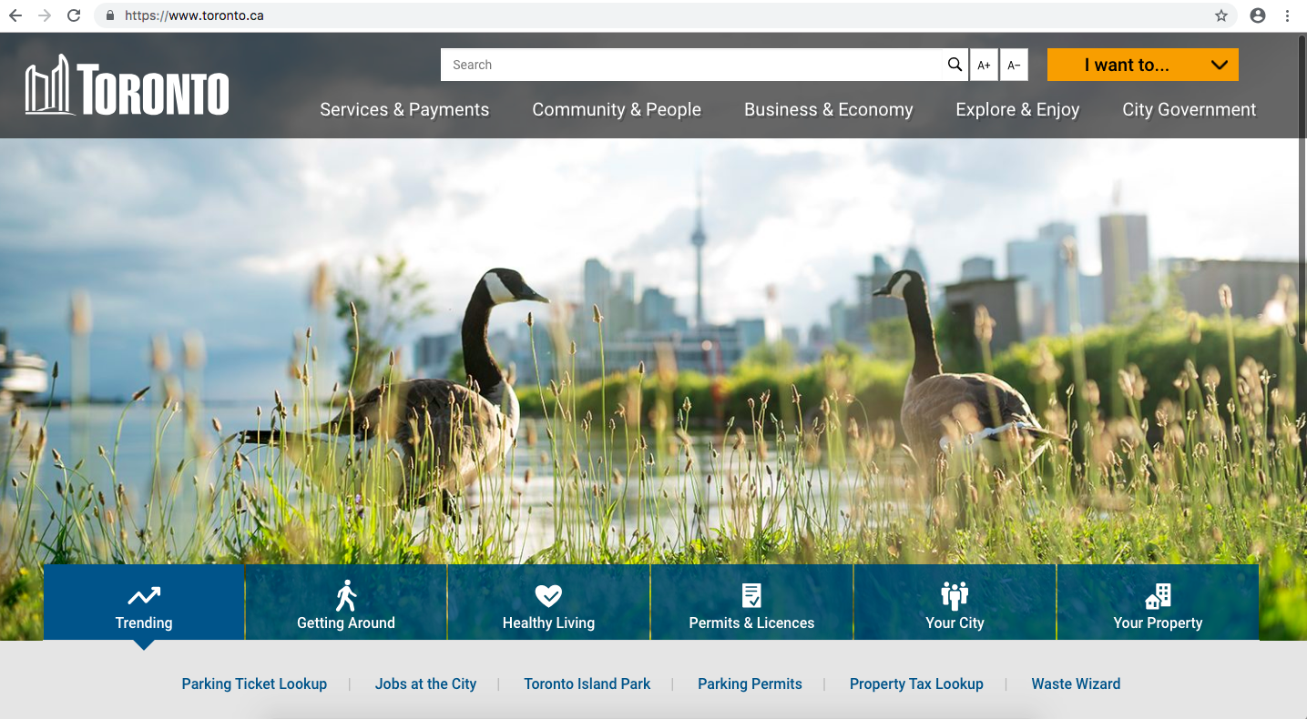
www.toronto.ca

Slide 23
www.toronto.ca
Child care in Toronto?

Slide 24
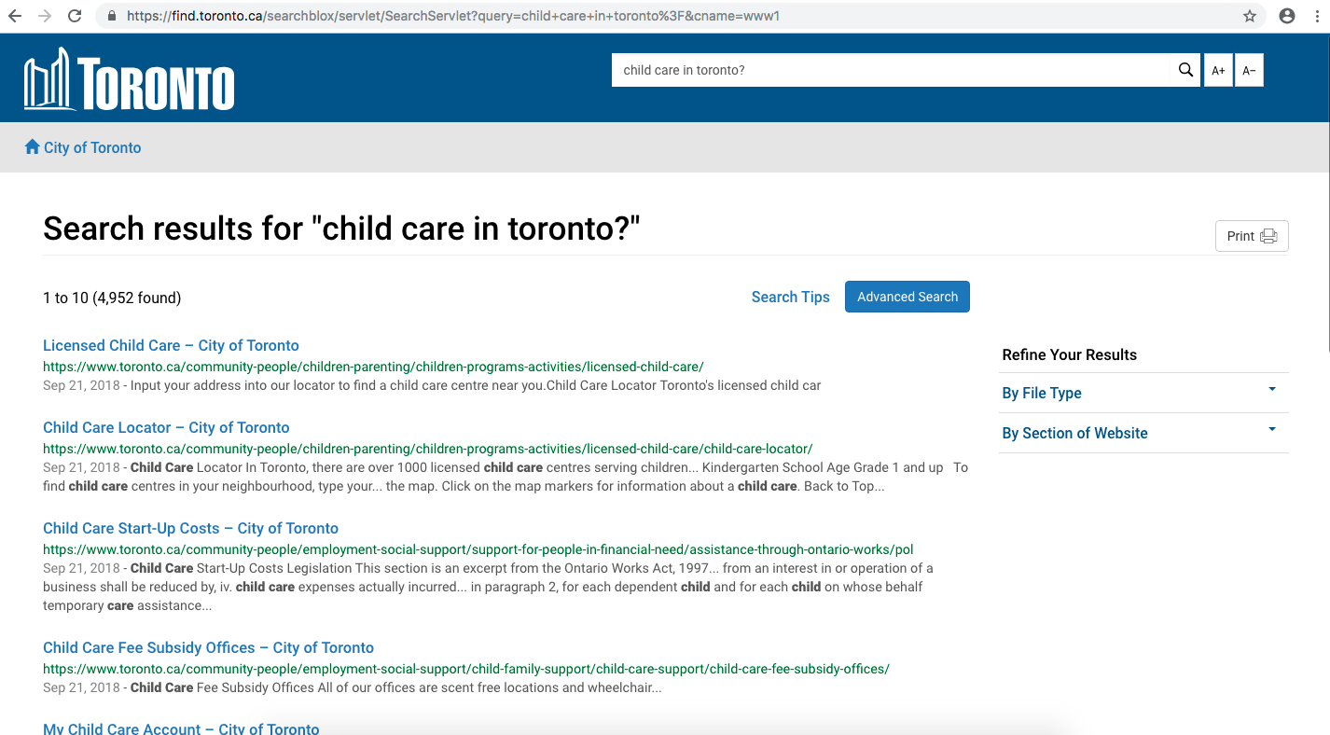
www.toronto.ca

Slide 25
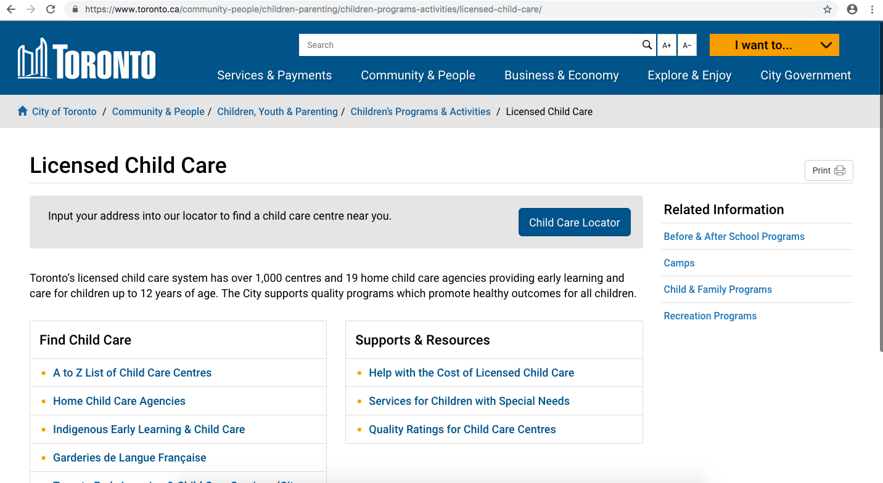
www.toronto.ca

Slide 26
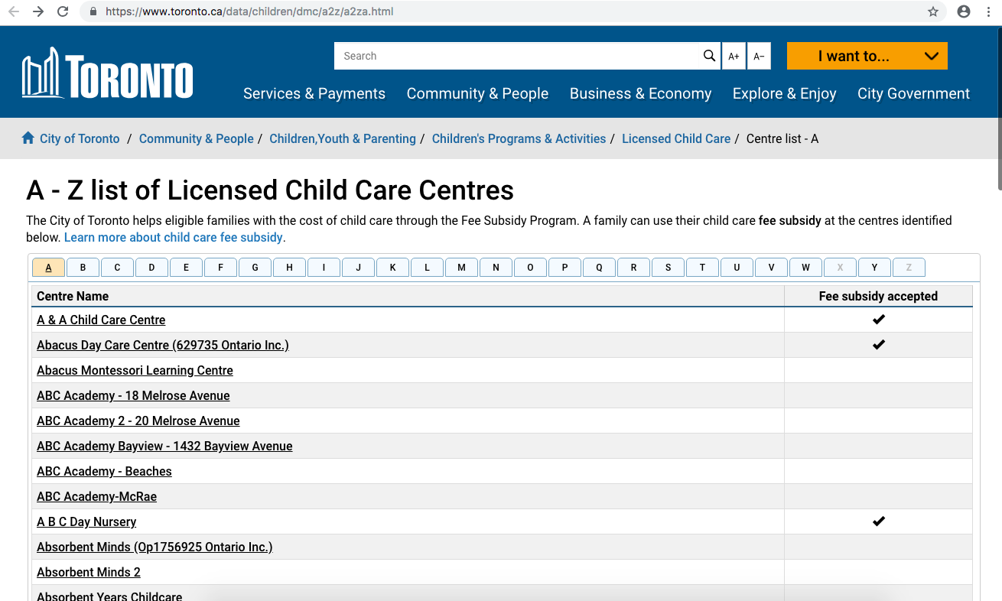
www.toronto.ca

Slide 27
www.toronto.ca

Slide 28
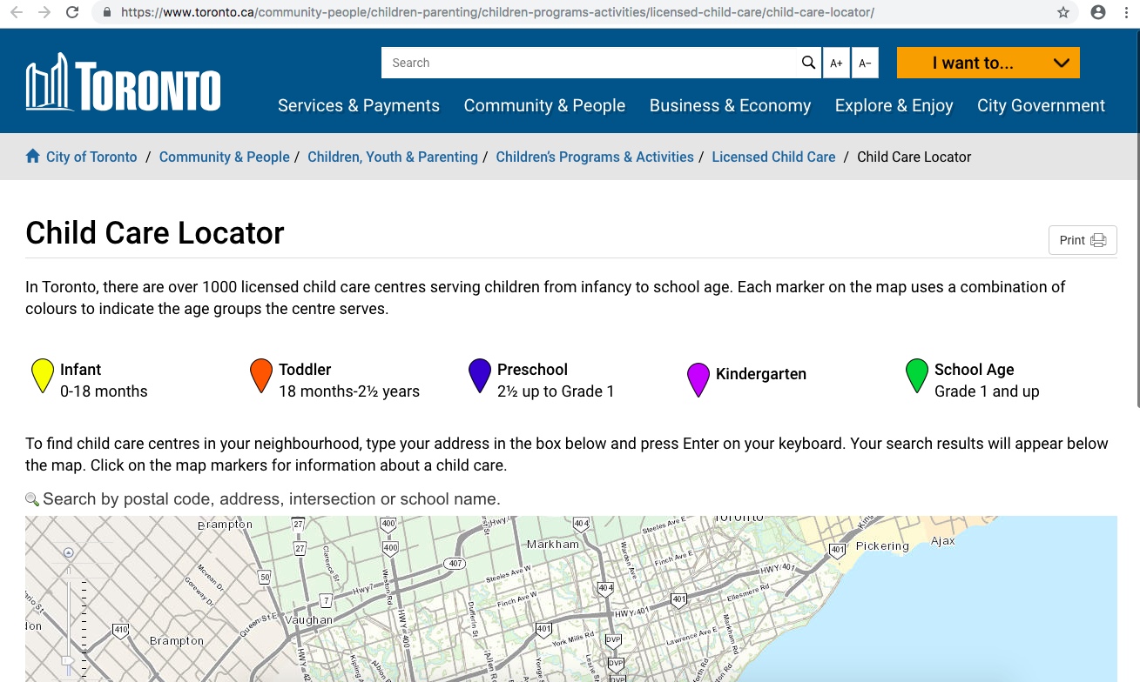
www.toronto.ca

Slide 29
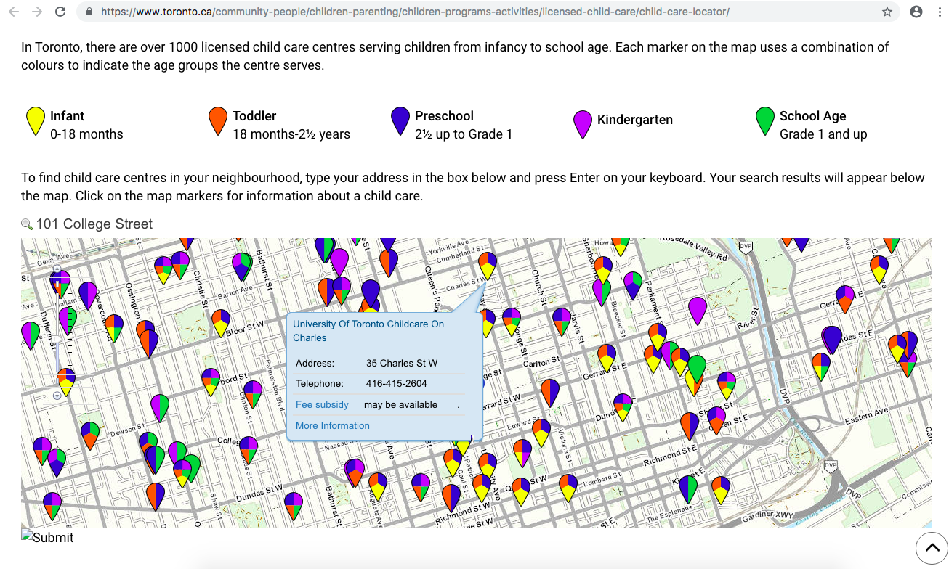
www.toronto.ca

